Slide 1
Sentiment Analysis

Slide 2
Problem Statement :
Identifying the sentiments about the product/brand from the tweets that can help the business take better actions.
What could be the possible business problems that are related to the data science problem you are solving?
The possible business problem can be wrong evaluation of the words from tweets which might affect the marketing team campaigns.
Notes:
Can we include some examples here?

Slide 3
Why solving this problem is important? - Business Impact
It would help any brand to understand the customer’s needs and their feedback will be valuable for
them to add more value to their product.
Who are the stakeholders for whom you are presenting the solution?
CEO, CFO, Marketing Team and Sales Department.
Any important assumptions you are making?
User’s tweets can be misleading sometimes as the use of sarcasm has made it very difficult
for NLP to understand the real meaning behind them.

Slide 4
What are the data points you currently have in the dataset?
tweet_id - Unique id for tweets.
tweet - Tweet about the brand/product
sentiment - 0: Negative, 1: Neutral, 2: Positive, 3: Can't Tell
If you had the opportunity, what additional data you would love to have?
Additional data would be Date_of_tweet, Age_of_Person, etc.

Slide 5
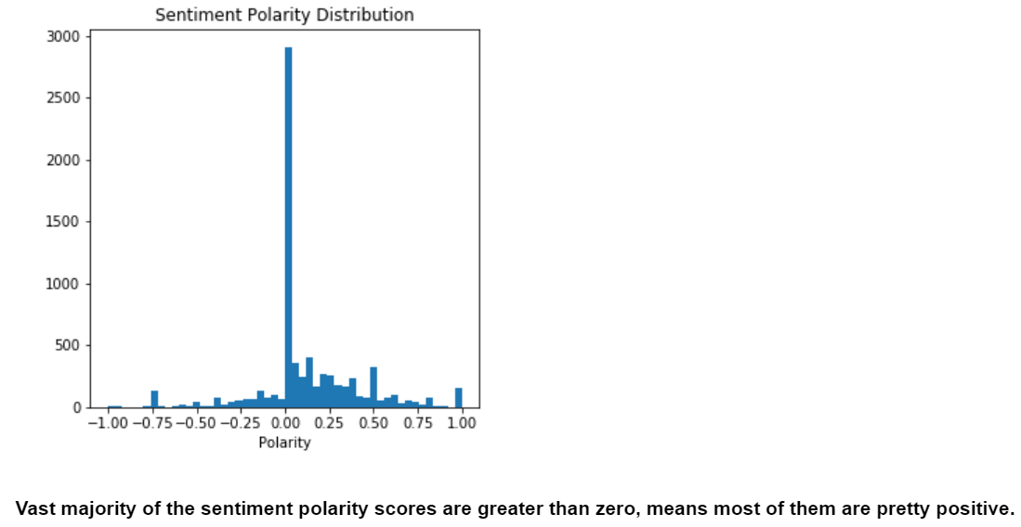
Exploratory Data Analysis

Slide 6
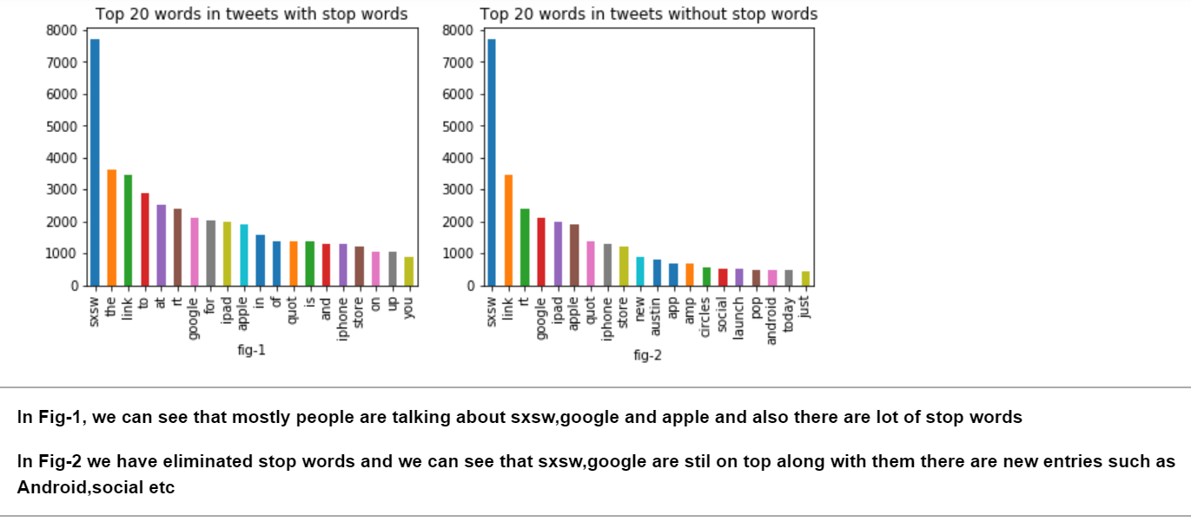

Slide 7
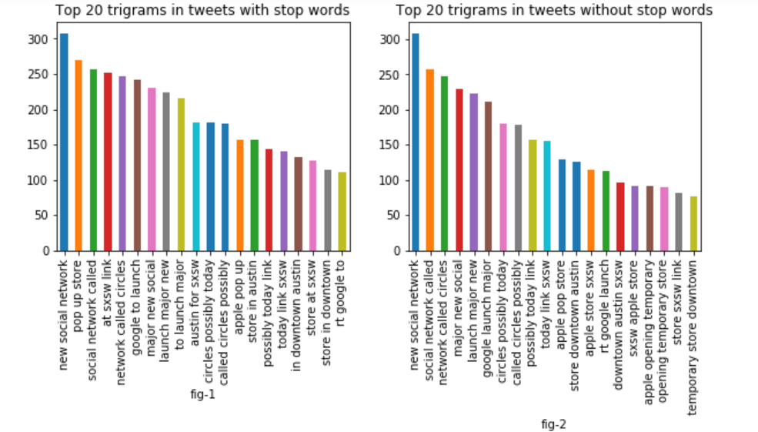
From below figure we can see that people are mostly talking about the launch of new Social Network such as Circles, Possibly today etc. and further looking at these trigrams it seems that google will launch them.

Slide 8
Pipeline
Removed blank comment from the data
Removed stop words, regular expression and tweeter handle.
Created new column Polarity , which has polarity of each sentiment

Slide 9
Models and Approaches
Used TfIdf Vectorizer with ngram range of 1-3, as it give low weight to terms occurring more often throughout comments
Did try Logistic Regression, Linear SVC with four sampling methods
Used SMOTE RandomOverSampling and SMOTE but results were not good.

Slide 10
Evaluation & Results
The selected metric was f1-score because it calculates :
The F1-Score is the 2*((precision*recall)/(precision + recall)).
The F1 score can be interpreted as a weighted average of the precision and recall.
To reduce both, False Negatives and False Positives we choose F1 score.

Slide 11
Final Results
Our final results were:
F1-Score – 0.68 on training data
F1-Score - 0.70 on portal
For the model which was finally selected

